Slide 1

Virtual Assistant

Slide 2


Index
I
Introduction
Existing and proposed system
Operating Environment
Brief description of technology
System analysis and design
Library Used
Implementation (output)
Drawbacks and Limitation
Conclusion

Slide 3
INTRODUCTION
Jarvis is a Virtual Assistant technology based on Artificial Intelligence
This software program use device’s microphone to receive voice requests and processing on it,and send response via speaker.
It is combination of different technologies like voice recognition,NLP,voice analysis.
This software program is developed using python and his modules

Slide 4



EXISTING AND PORPOSE SYSTEM

Slide 5
OPERATING ENVIRONMENT
Software and Hardware Requirement
Processor:- Apple M1,intel i5 3 generation
Memory:- 8GB
Operating system:- Window,Mac os
Software:- Must installed python 3.11
IDE:- JetBrains PyCharm

Slide 6
BRIEF DESCRIPTION OF TECHNOLOGY USED
Python-Python is a computer programming language often used to build websites and software, automate tasks, and conduct data analysis. Python is a general-purpose language, meaning it can be used to create a variety of different programs and isn’t specialized for any specific problems.
NLP-NLP stands for Natural Language Processing, which is a part of Computer Science, Human language, and Artificial Intelligence. It is the technology that is used by machines to understand, analyse, manipulate, and interpret human's languages. It helps developers to organize knowledge for performing tasks such as translation, automatic summarization, Named Entity Recognition (NER), speech recognition, relationship extraction, and topic segmentation.
Speech Recognition:-is an important feature in several applications used such as home automation, artificial intelligence, etc. This article aims to provide an introduction to how to make use of the SpeechRecognition library of Python. This is useful as it can be used on microcontrollers such as Raspberry Pi with the help of an external microphone.

Slide 7
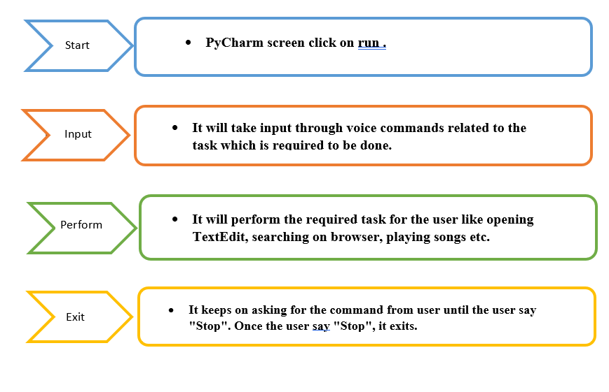
Data Flow Diagram
SYSTEM ANALYSIS AND DESIGN

Slide 8
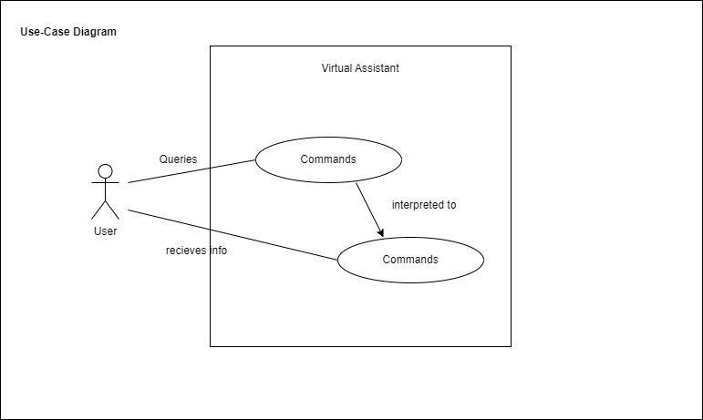
Use case

Slide 9
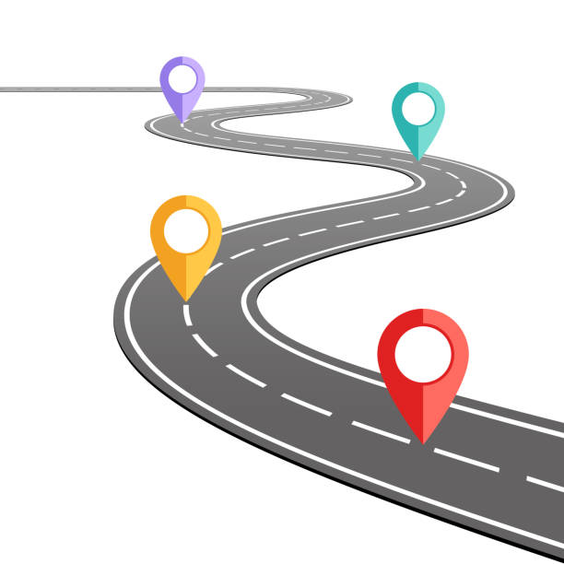
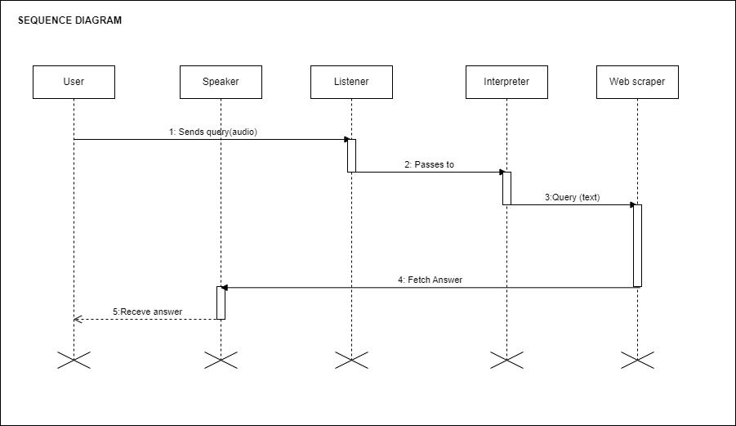
Sequence Diagram

Slide 10
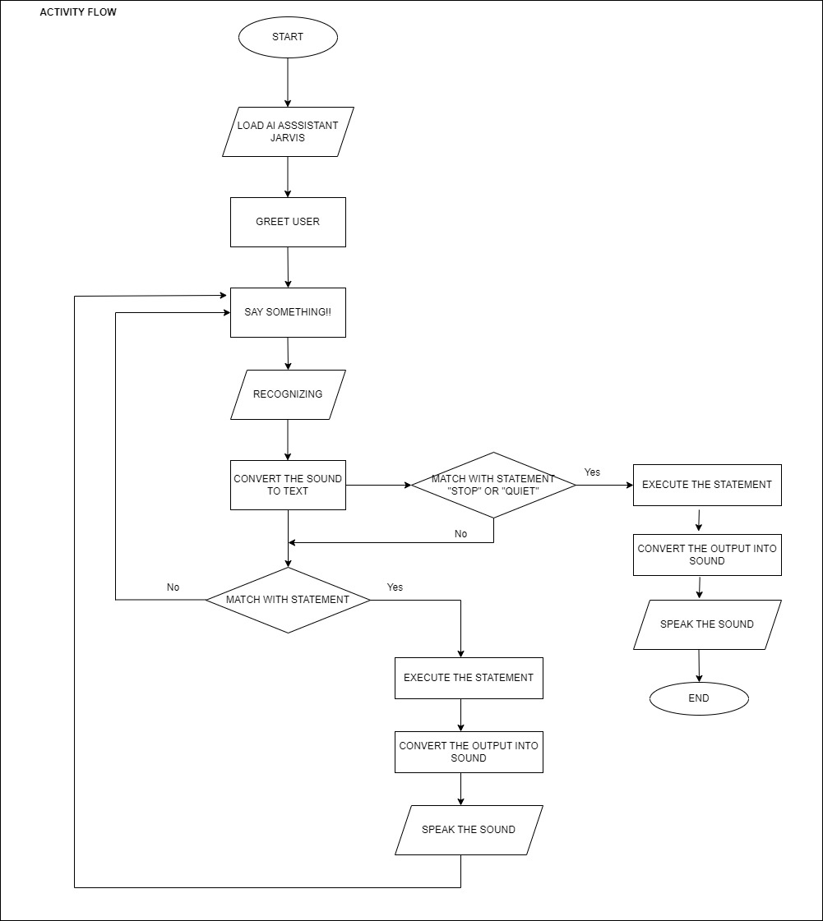
Activity Diagram

Slide 11
LIBRARY USED
Subprocess
Pyttsx3
Speech recognition
Datetime
Wikipedia
Webbrowser
OS
Pyjokes
Smtplib
Ecapture
Pywhatkit
Pyaudio
Requests

Slide 12

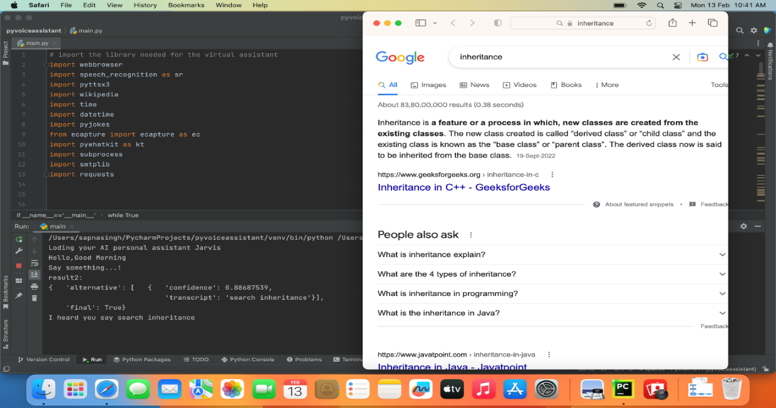
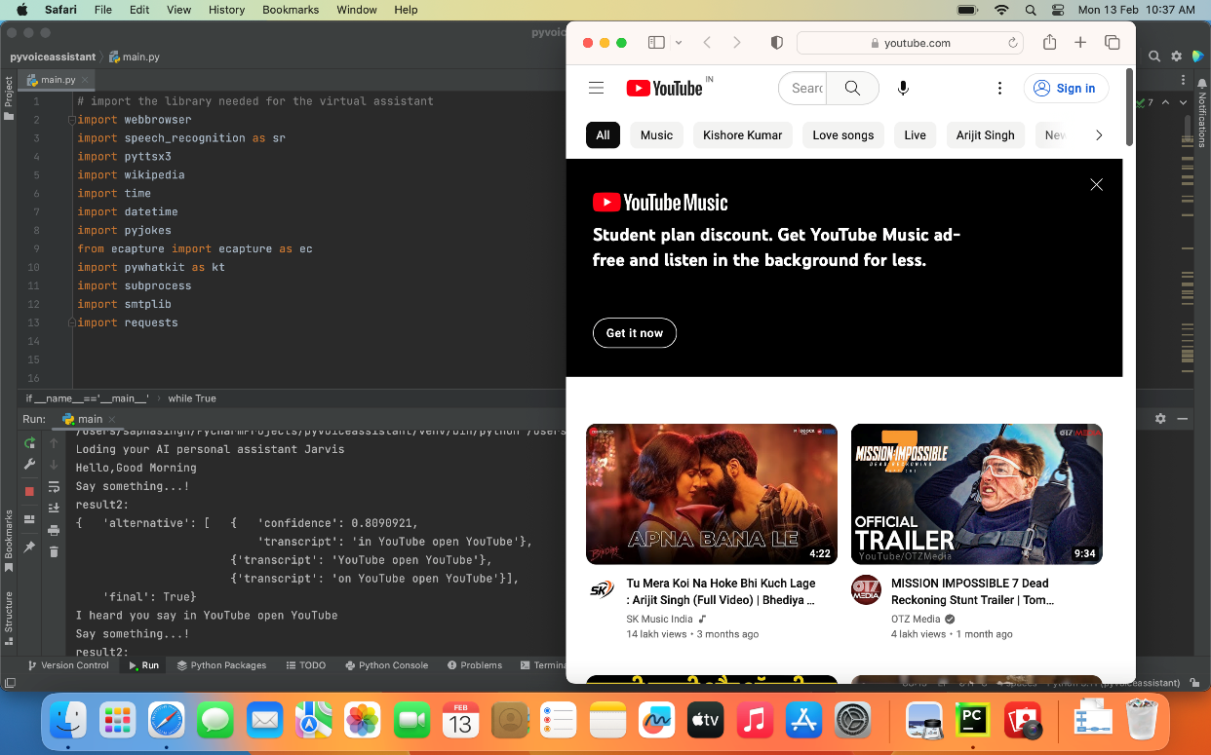
IMPLEMENTATION

Slide 13
DRAWBACKS AND LIMITATION
It need a internet connection
Security is somewhere an issue, there is no voice command encryption in this project.
Background voice can interfere.
Misinterpretation because of accents and may cause inaccurate results.
JARVIS cannot be called externally anytime like other traditional assistants like Google Assistant can be called just by saying, “Ok Google!”
Internet Connection
High data use
Hindi language is not supported
Voice recognition isn't perfect
Language Barrier
Security and privacy
Make humans lazy
No creativity

Slide 14
CONCLUSION
In this paper we have discussed about Personal Virtual Assistant For Mac os Using Python. Virtual assistant makes life easier to humans. virtual assistant is the flexibility to contract for just the services they need. We use Artificial Intelligence technology for this project. Virtual Personal Assistants are effective way to manage or organize your schedule. Virtual Personal assistants are also reliable than Human Personal Assistant because, virtual personal Assistants are more portable, loyal and available to use anytime. Our virtual assistant will be intimate you with suggestions and taking instructions, and will know more about you. We can expect this device to be permanent.
Features :-Greet user, Search anything on google, Tell a random joke, Open YouTube, Can play any song on YouTube, Open mail, Open current news, Tell Current Date And Time, Launch Windows Application, Send Email, Tell about weather of any city, Tell about any person(via Wikipedia), Easy to use, Question related to MCA admission in Dy Patil School of MCA

Slide 15
Thank you

